Slide 1


CSB4301 – Theory of Computation
B.Tech – IVth Semester
NFA to DFA Conversion
Mr. D.S.John Deva Prasanna AP(SG) & Ms.Vanathi, AP,CSE
Department of Computer Science and Engineering

Slide 2
Converting a NFA into DFA
We have seen for any given language there exists a DFA, a NFA as well as a ε NFA.
In this session we are going to convert NFA to DFA.
The DFA derived from the NFA will accept the same Language as the NFA (i.e same set of Strings).
In this case we say NFA and DFA are equivalent.

Slide 3
Subset Construction Method
Consider
N=(Q_{N},∑,δ,q₀, F_{N}) is a NFA which accepts the language L(N)
D=(Q_{D},∑,δ,{q₀}, F_{D}) is a DFA which accepts the language L(D)
The conversion attempts to derive DFA from NFA so that L(N)=L(D).
Input alphabet of both the automata is same.
The start state of DFA is the set which contains only the start state of NFA.
Not all the states are reachable from the starting state and can be removed from the automata

Slide 4

Subset Construction Method
The other components are constructed as follows
Q_{D} is the subset of Q_{N} i.e Q_{D} is the power set of Q_{N.} If Q_{N} has n states then Q_{D} will have 2^{n} states.
F_{D} is a subset of Q_{N} which contains at least one state from F_{N}.
Mathematically F_{D} is a subset S of Q_{N} such that S Ո F_{N} ≠ φ
For each set S C Q_{N} for each input symbol ‘a’ in ∑.

Slide 5
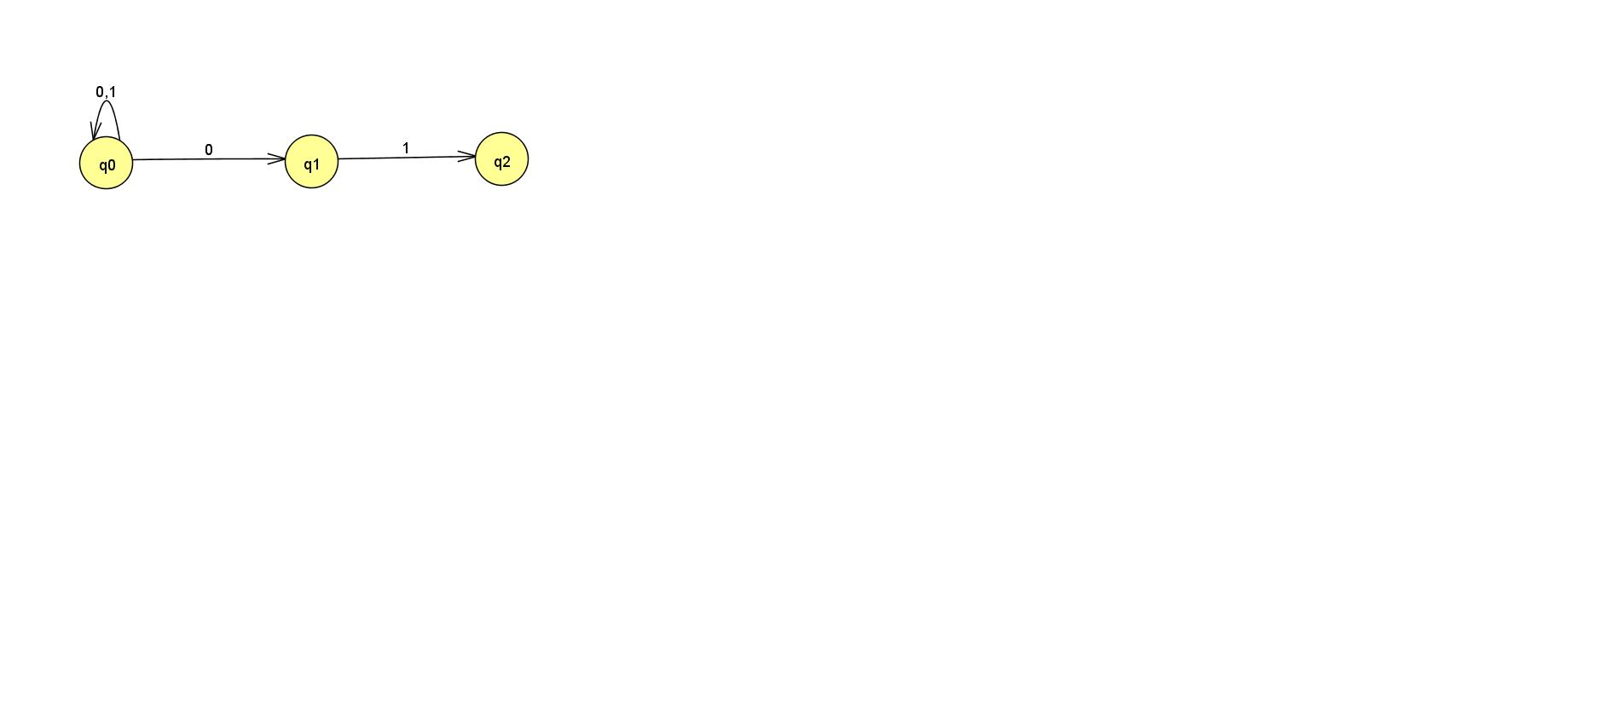
Sample NFA which is to be converted into a DFA

Slide 6
The power set of the NFA is
Q_{n} ={q0,q1,q2}
The power set is
{}, {q0},{q1},{q2},{q0,q1}, {q1,q2}, {q0,q2}, {q0,q1,q2}
Find the transition for all of these states for the input alphabet of the
NFA.
Delete all the unreachable states.

Slide 7
Thank You

